Slide 1
Monash University Fintech Boot Camp – Project 1
Crash Incidence Analysis for The State of Victoria - An Investigation for Safety Ratings.
Ashwin Rao
Timothy Watson
Hardy Ty
Nick Hugh

Slide 2

Motivation/Summary
1
2
3
What are the factors influencing the likelihood of a crash occurring in Victoria?
When a crash occurs in Victoria, what are the factors affecting the likelihood of death occurring?
How can we commercialise this analysis and also improve the safety of Vic Roads?
Questions
Ensure increased safety in Victorian Roads and ultimately reduce the economic impact of life loss
Core Message
3 Stage Analysis
A monthly suburb highlight, blooming and booming the city once again
Analysis of the impact of location on the incidence of accidents in Victoria
Assessment of various variables on the number of deaths that occur when a crash occurs
Creation of a rating scale that considers the safety of LGA in relation to crash incidence
Analysis
Crash Incidence heavily related to population density
Deaths linked to lighting conditions and proportion of vehicles to pedestrians
Our rating scale aims to reduce the impact of the $220,000 cost of a loss of life
Findings

Slide 3
| Data Used

Slide 4
Questions and Data
Our Questions and Data Used To Answer Them
Question 1
Question 2
Question 3
What are the factors influencing the likelihood of a crash occurring in Victoria?
When a crash occurs in Victoria, what are the factors affecting the likelihood of death occurring?
How can we commercialise this analysis and also improve the safety of Vic Roads?
Better understand the reasons for a crash occurring
Highlight changes that can be made to reduce accident incidence
What factors may heighten a crash to result in deaths occurring
Highlight changes that can be made to reduce deaths in accidents
Synthesise findings to create a safety rating for LGAs - this rating can be sold to the LGAs
Reduce the economic impact of losing lives to car crashes
Data Used
Data Used
Data Used
Victorian Government Crash Statistics - 490949 Crash Incidences from 2006 to 2020
CSV Format;Included - Location Age,Gender,Lighting Conditions ETC
Victorian Government Crash Statistics - 490949 Crash Incidences from 2006 to 2020
CSV Format;Included - Location Age,Gender,Lighting Conditions ETC
Victorian Government Crash Statistics
Australian Life Tables 2015-17
Value of life - Wikipedia

Slide 5
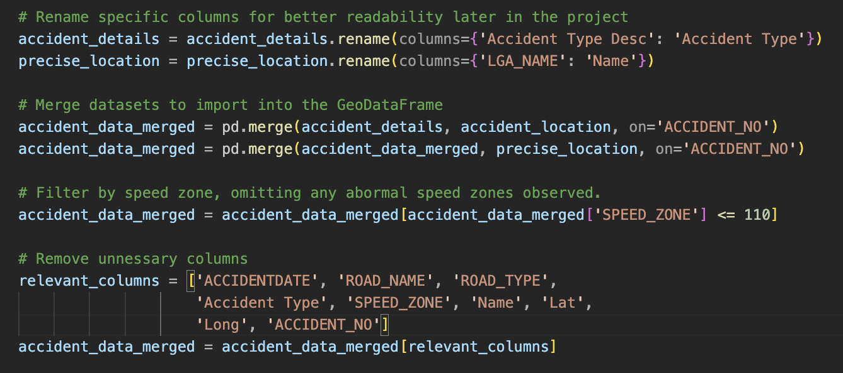

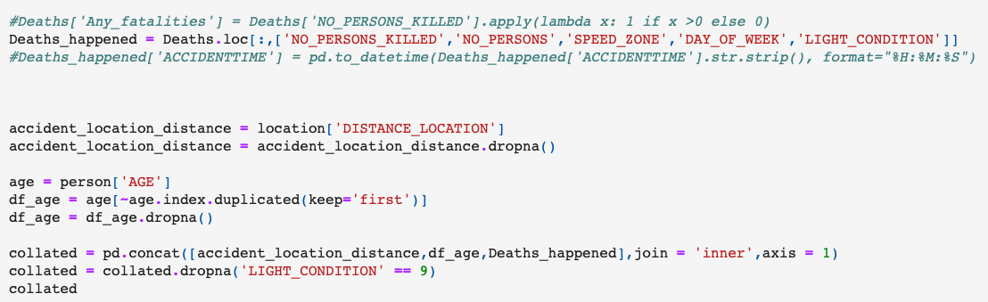
Data Cleanup
Location Analysis Data Cleanup
Replaced ‘-9’ for missing data with ‘na’
Concatenation of multiple CSV sources

Slide 6
| Project Outline

Slide 7

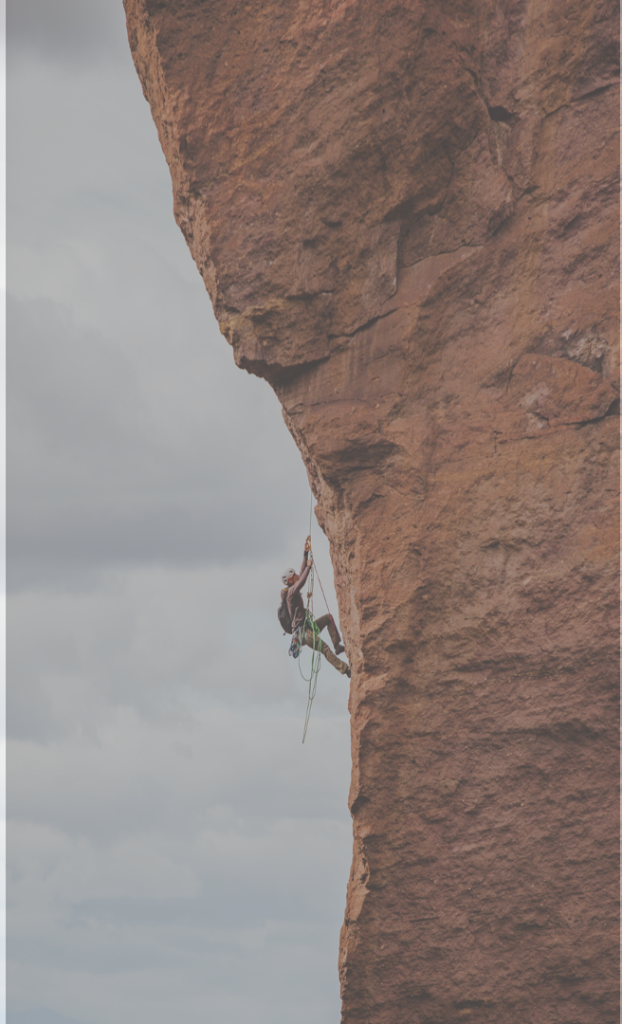

1
2
3
Accident Incidence Analysis
Death Incidence Analysis
Fintech Use Case
Proposed a rating system which uses the key factors we have identified to suggest a safety rating for a particular LGA. Ultimately, aiming to reduce the number of people involved in crash incidences and thus limiting the economic cost of death
Using data, we conducted an analysis as to the effect of the location of an incident on the severity of a crash that occurred within that region
Considered the impact of a range of factors on the number of deaths occurring from a crash in Vic both individually as well as part of a linear regression model

Slide 8
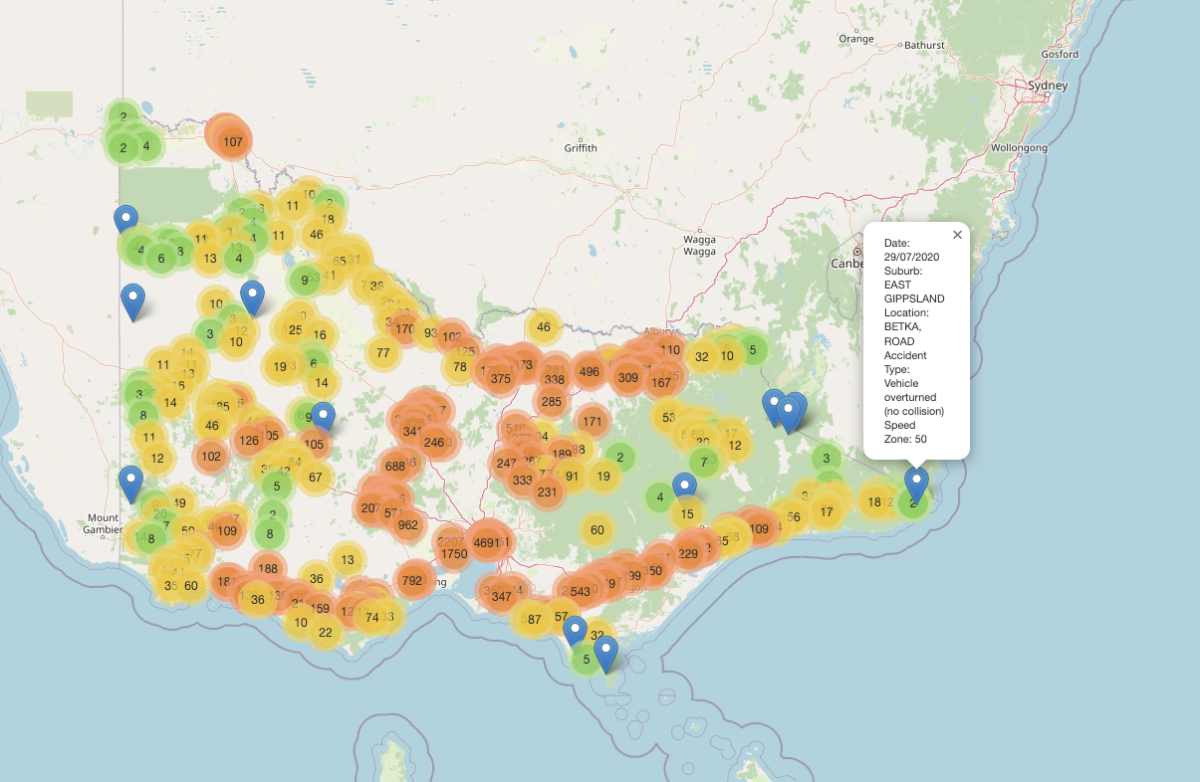
Location Analysis
An Interactive Map was created to enable anyone to investigate the historical data of all crashes in Victoria from 2006 to 2020.
The map displays accidents with the specific details of the accident being displayed with a popup feature once hovered over with the mouse.
The colouring of the locations change with the density of accidents recorded in the specific area. Higher density areas appear as orange, whereas lower density areas appear as green until the specific geographical location of the accident is observed.
For further analysis, each specific year can be toggled on and off to determine trends quickly.
The most obvious observable data that can be derived from the location analysis is the more dense the population, the higher the rate of accidents in that area.
Another trend that can be seen is the increase in the frequency of accidents in regional areas as the years increase. This can be associated with further analysis later in the presentation where lighting conditions influence accident outcomes.
Interactive Crash Analysis Map Link

Slide 9
| Analysis

Slide 10
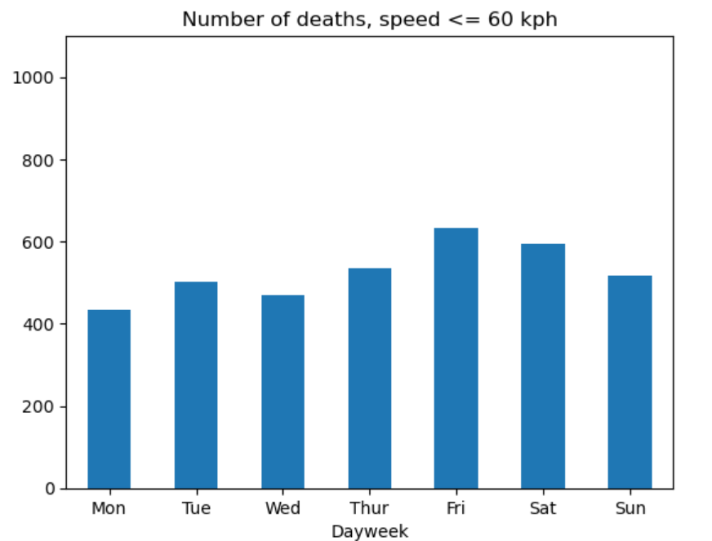
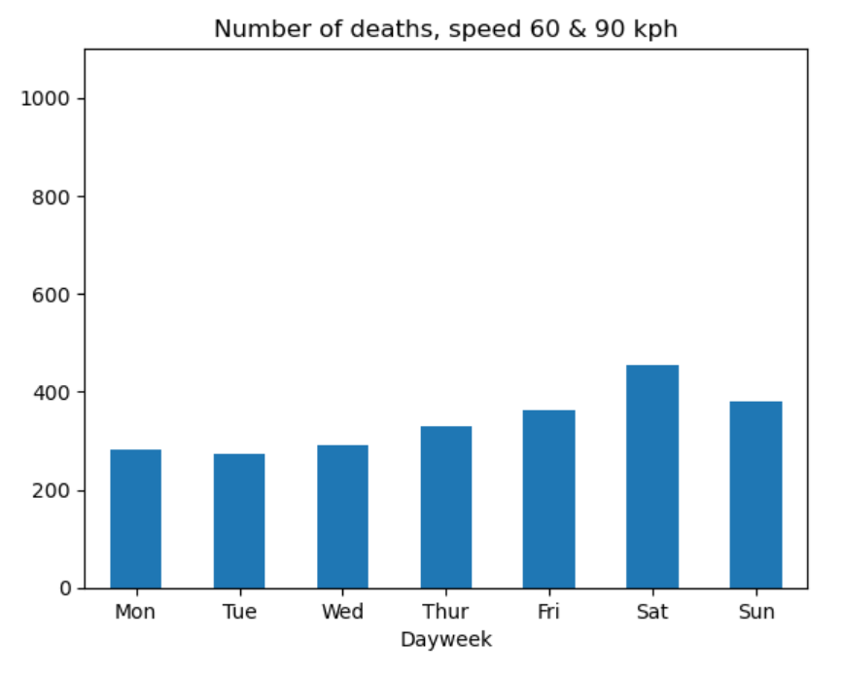
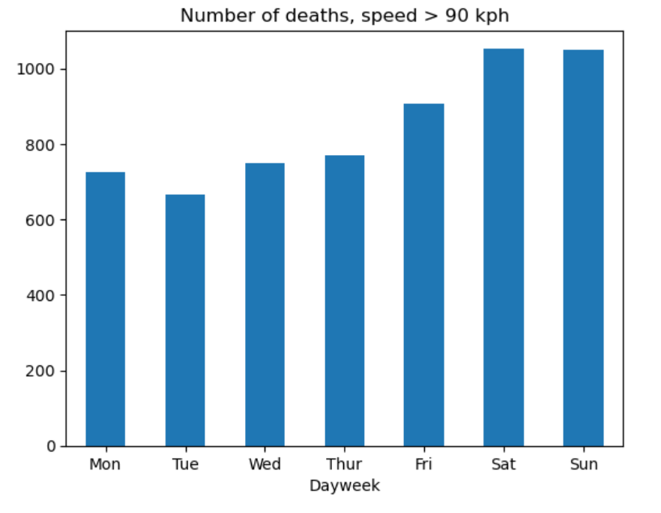
Motor Vehicle Deaths By Speed Limit
Speed limit deaths peaked towards the weekend
2
Mid-Range speed limit deaths lower than slower <= 60kph
Possibly due to congestion
Contradictory as slower should be safer
1

Slide 11
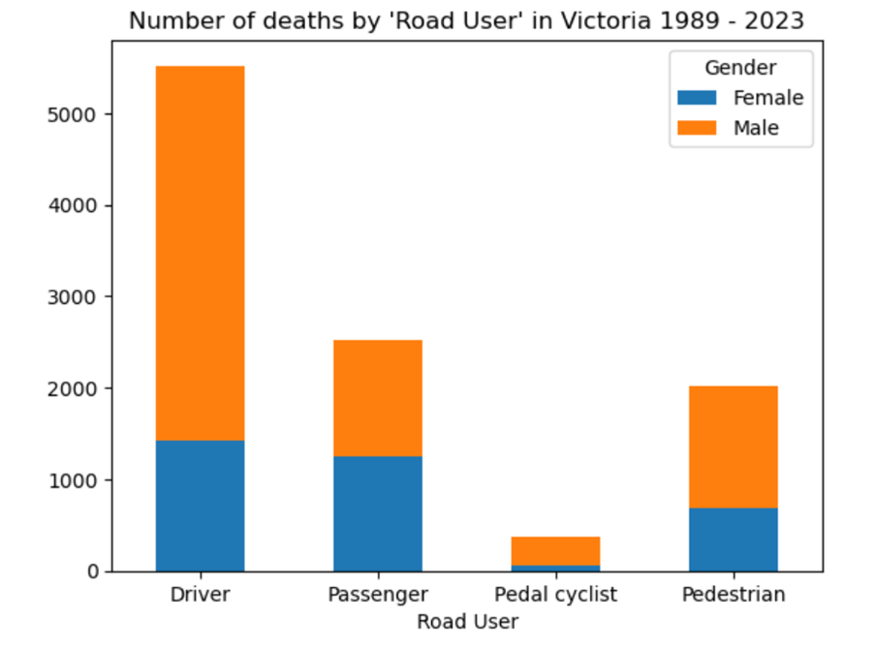
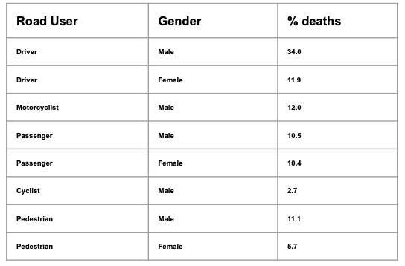
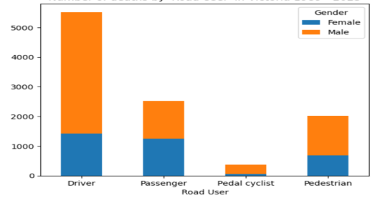
Motor Vehicle Deaths By Gender In The State of Victoria
Number of Deaths By ‘Road User’ In Victoria 1989-2023
Percentage of Deaths By Gender and ‘Road User’
1
2
3
Male Driver Deaths 3x Female Drivers
Motorcycle rider deaths almost exclusively male
Passengers deaths are equally weighted male and female
4
5
6
Cyclists death considerably lower than pedestrian and drivers
Cyclists deaths are predominantly male
Male pedestrian deaths are twice as likely as female
2.3 million increase in revenue for local businesses by 2024
2
Increased cultural
significance of Sydney
CBD marked by traction
3

Slide 12
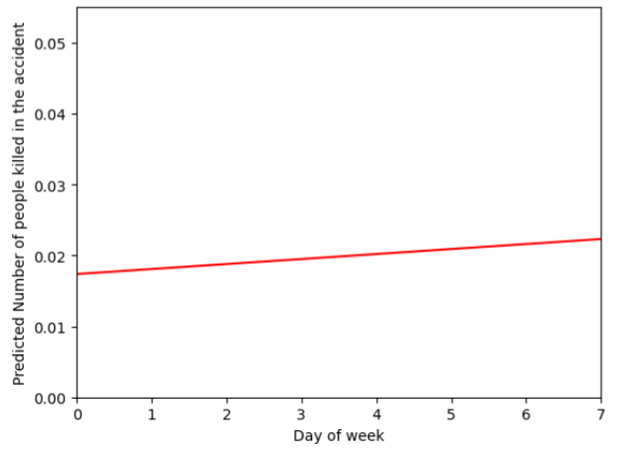
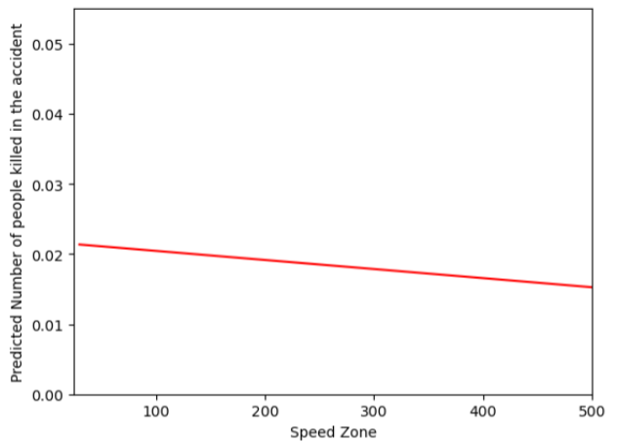
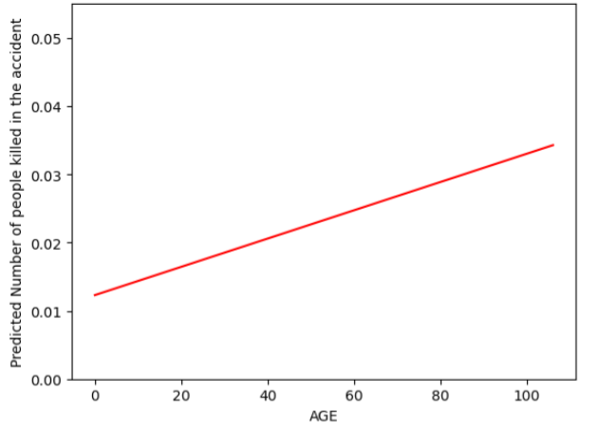
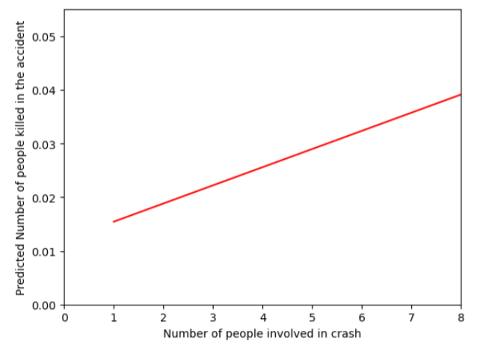
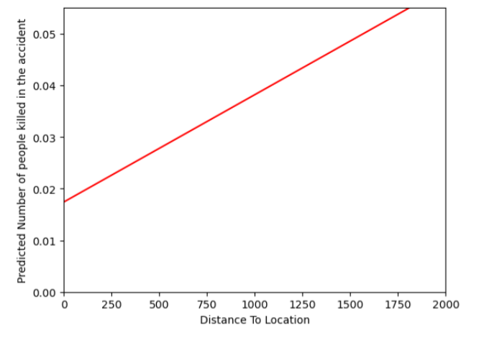
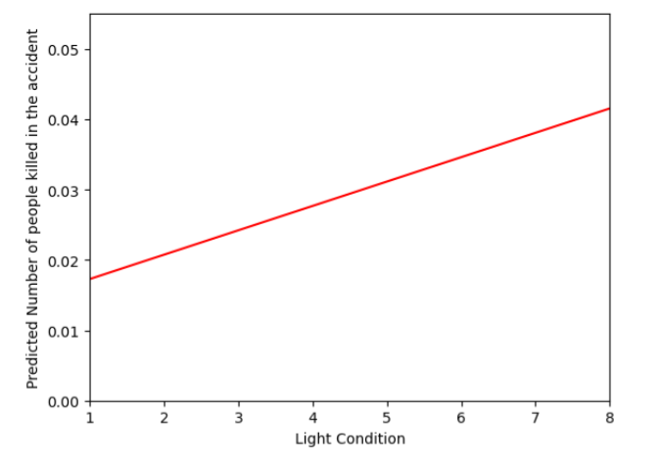
How many people may die from a particular accident -> Linear Regression
Linear Relationships Between Key Factors Affecting Accident Occurrence and The Number of Deaths
A
Relationship Between Persons Killed In An Accident and Speed Zone
C
Relationship Between Persons Killed In An Accident and Day of The Week
B
B
Relationship Between Persons Killed In An Accident and Age
D
Relationship Between Persons Killed In An Accident and Number of Persons Involved in Crash
E
F
Relationship Between Persons Killed In An Accident and Distance To Location
Relationship Between Persons Killed In An Accident and Light Condition

Slide 13
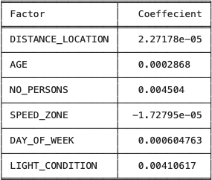

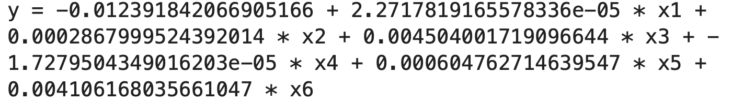
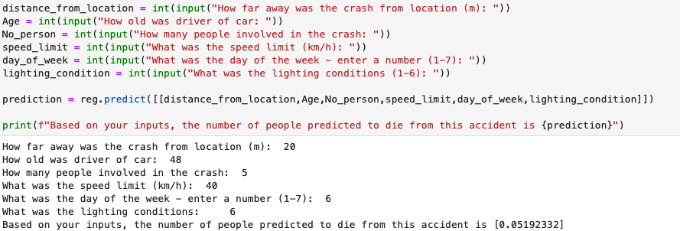
Predictive Model
A model that predicts the number of deaths to occur from a particular accident
1
The effect of each factor on the number of deaths is represented through their coefficient value in a linear regression
3
2
Ranking the effect of each of these factors on the number of deaths in an accident
Predictive Model Calculator
No Persons Involved
Light
Condition
Day of week
Impact on death numbers
AGE
Distance to location
Speed
Limit
Government Alteration Possibility
Greatest impact and possibility for government change is in relation to lighting conditions

Slide 14
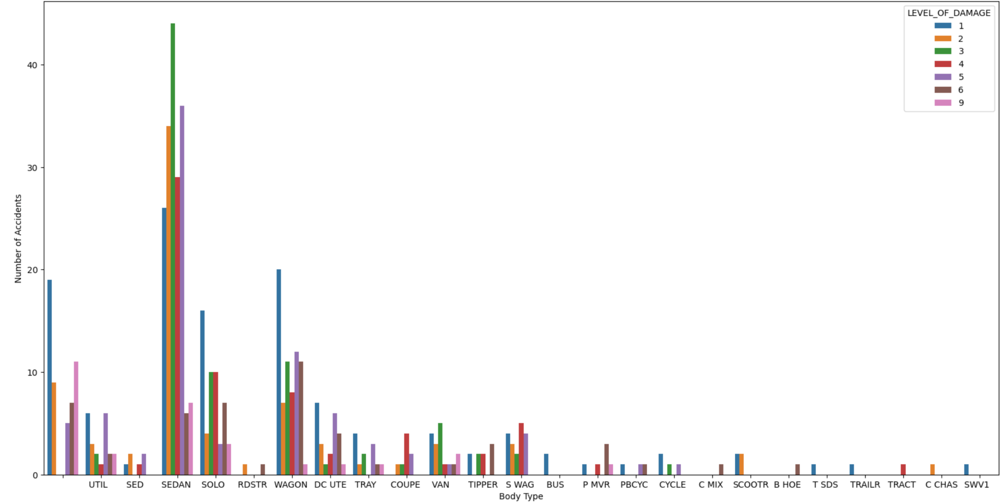
Level of Damage Based on Body Type

Slide 15
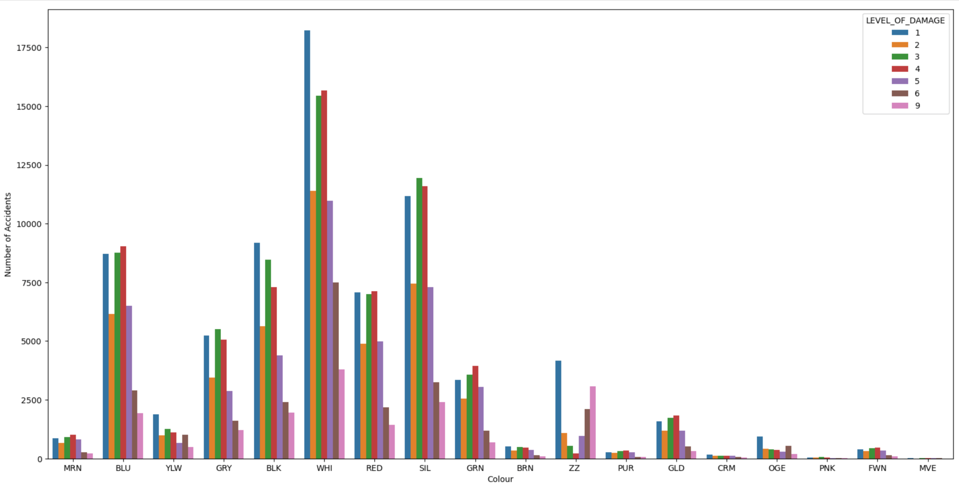
Number of Accidents Based on Colour

Slide 16
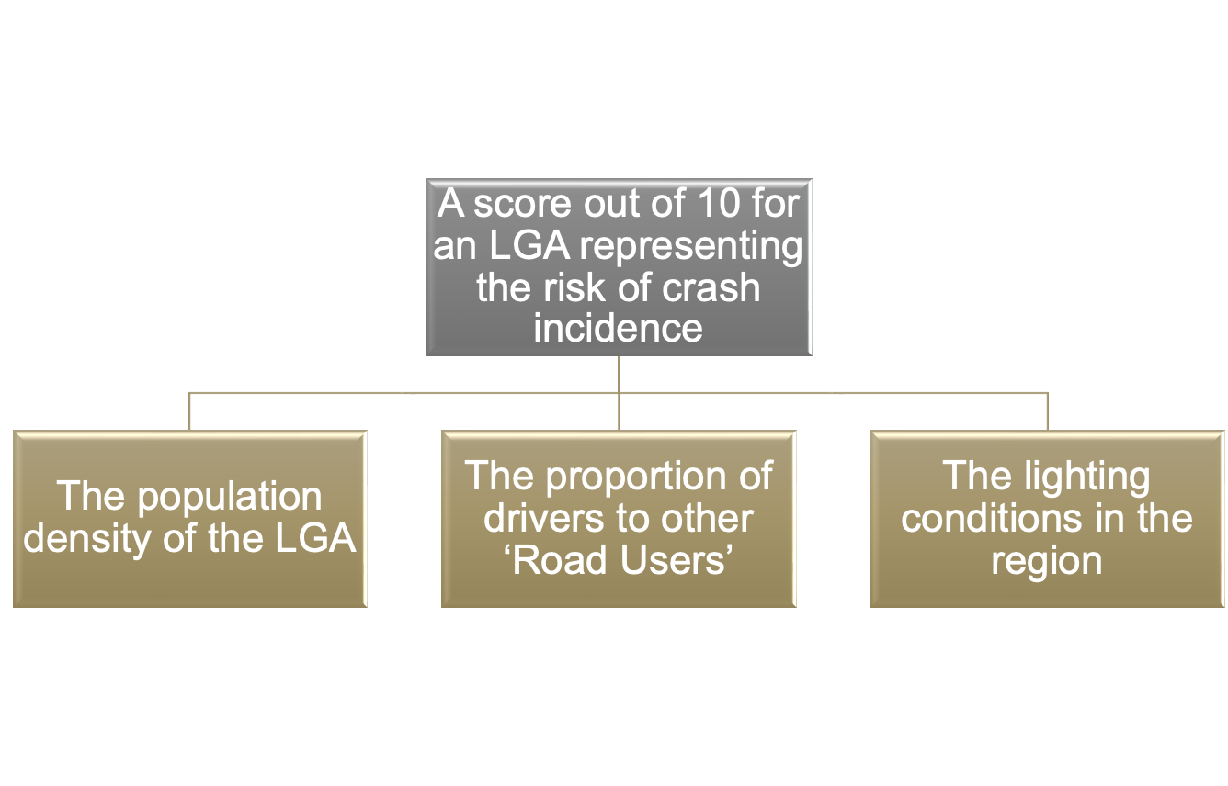
Fintech Use Case
How Our Rating System Will Work
Why We Need This Rating System
Years of life estimated to be lost from road deaths, Victoria 1989-2023:
Males 370,989, females 146,394
Economic cost estimated to be $220,000 per year, per person
These 3 Factors will be primary factors of consideration when calculating an LGAs final rating
Our rating system aims to incentive LGAs to reduce incidences of crashes and deaths, ultimately contributing to a reduction in Economic cost of loss of life

Slide 17
Discussion/postmortem
Important Findings
Project Difficulties
1
Light conditions significantly impact on the likelihood of a crash causing death
Lack of analysis as to level of risk exposure
Using our analysis to consider a fintech use case
Limiting the scope of our analysis to consider only important factors
2
Population density significantly correlated with crash incidence
2 More Weeks?
1
Consider other factors like flooding, fire etc in our LGA score
Proportion of drivers to other ‘Road Users’ has a significant impact of number of deaths in a LGA
3
2
Try to find data on the level of traffic in each area
we to conduct a more holistic analysis - Use API?

Slide 18
Nick Analysis 1.
Data
Analysis based on the ‘Australian Road Deaths Database’
Australian Life Tables 2015-17
Value of life - Wikipedia
Exposed to risk data was not available
Data cleaning
Replaced ‘-9’ for missing data with ‘na’
Filtered for Victoria.
The unique identifier, ‘Crash ID’, was re-typed to string
The categorical ‘Weekdays’ shortened to ‘Mon’, ‘Tue’... and sorted
Factors covered
included speed limit, gender, road type, road user
Observations
Mean Male death age 39, females 45
Years of life estimated to be lost from road deaths, Victoria 1989-2023
Males 370,989, females 146,394
Economic cost estimated to be $220,000 per year, per person

Slide 19
